Slide 1

Dining Hall Management System
Group 4
IST-659 DATA ADMIN CONCEPTS AND DATABASE MANAGEMENT
TEAM MEMBERS:
SAI SUBRAHMANYA AKHIL BADAMPUDI
SAMPADA REGMI
VRUSHALI LAD
VISHAL REDDY VANGA

Slide 2
BUSINESS PROBLEM
At Syracuse University, there are five major dining halls, namely Ernie, Shaw, Sadler, Brockway, and Graham. These dining halls collectively employ over 500 part-time student workers, who work to earn their weekly wages
At each dining hall, student supervisors manually manage the shifts of over 500 part-time student workers. These students pick shifts based on their preferred time slots, and the supervisors use Excel sheets to manage the scheduling process.
The current process at the dining halls is causing several issues, including errors in scheduling, confusion among student workers regarding their working hours, and a lack of transparency in tracking employee progress.
This project aims to create a comprehensive database for the dining halls to facilitate easy access to shift schedules and available working hours, reducing confusion and increasing transparency and efficiency for student employees, supervisors, and managers.

Slide 3
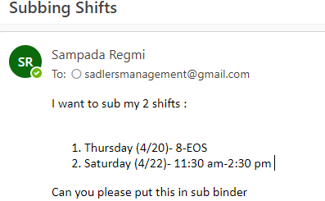
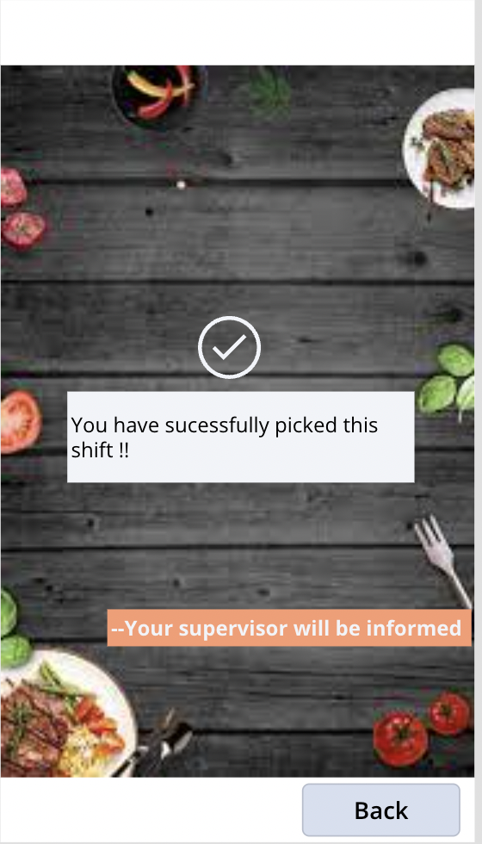
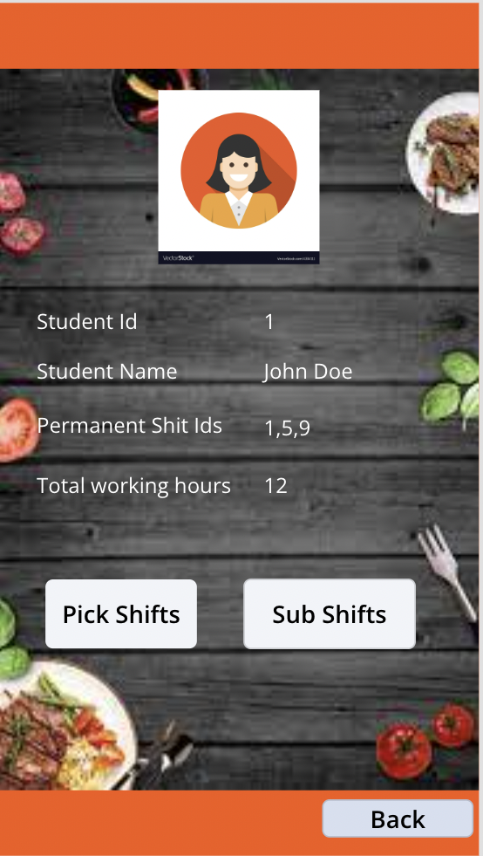
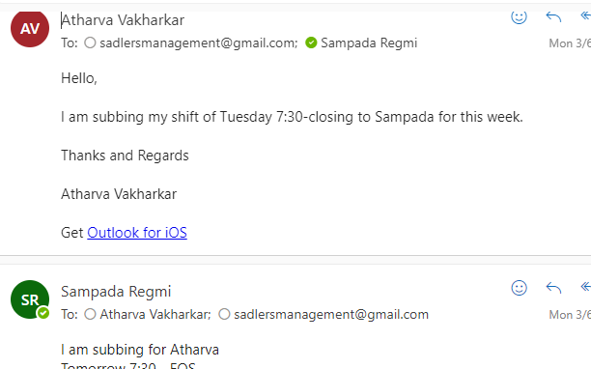
Manual Process
VS
OUR PROJECT

Slide 4
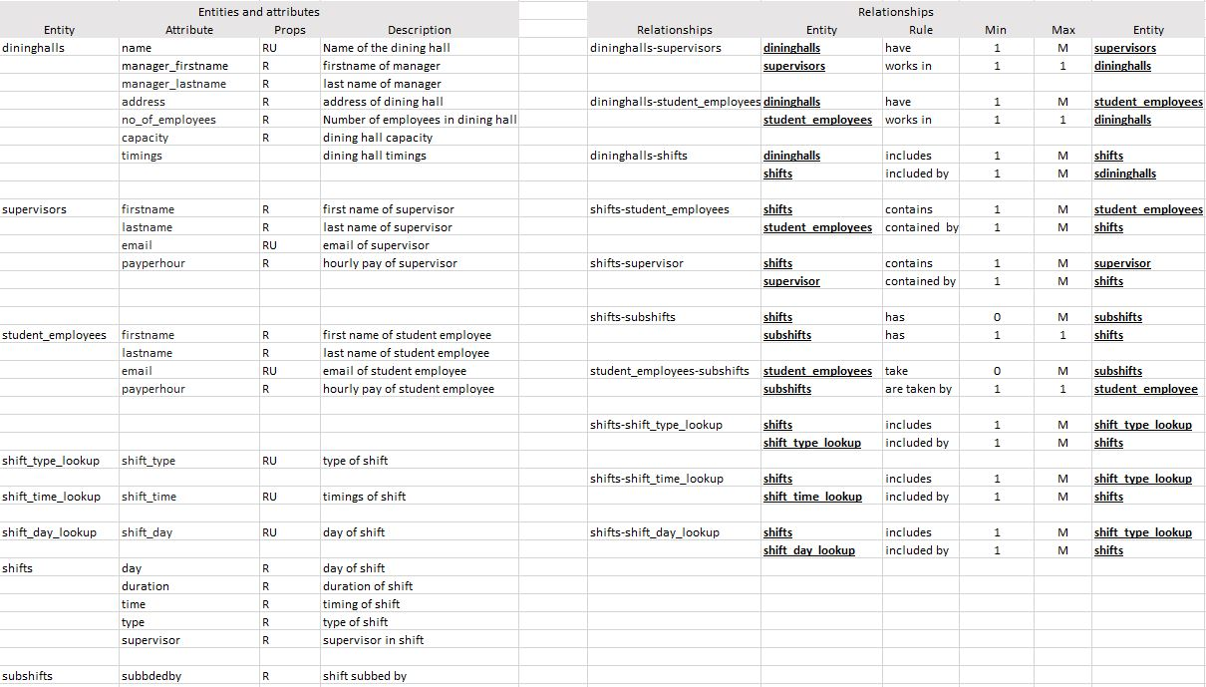
ER-Data Requirements

Slide 5
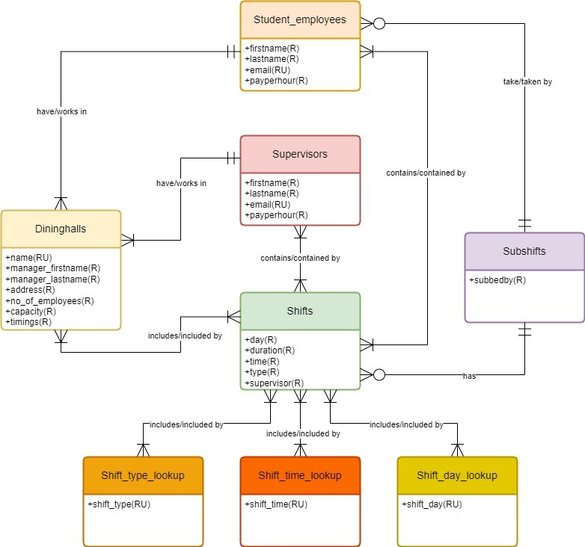
Conceptual DATA MODEL

Slide 6
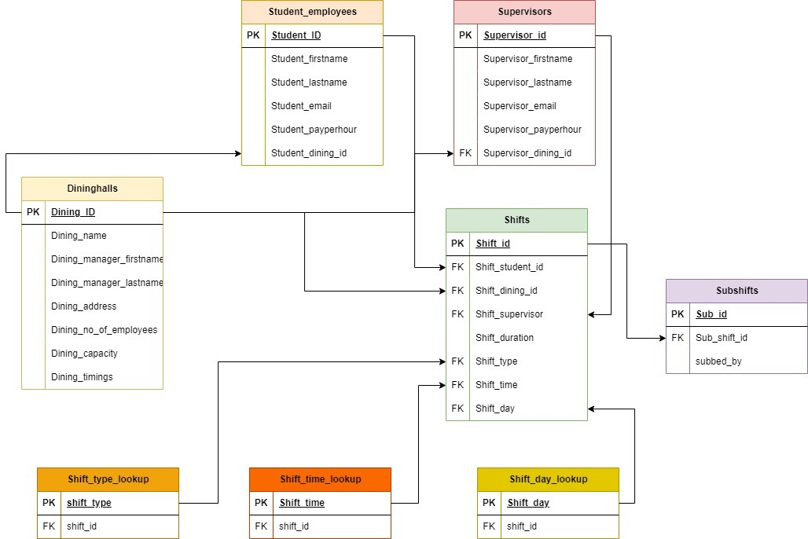
Logical DATA MODEL

Slide 7
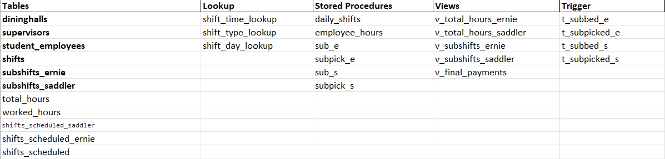
Database Consists of...

Slide 8
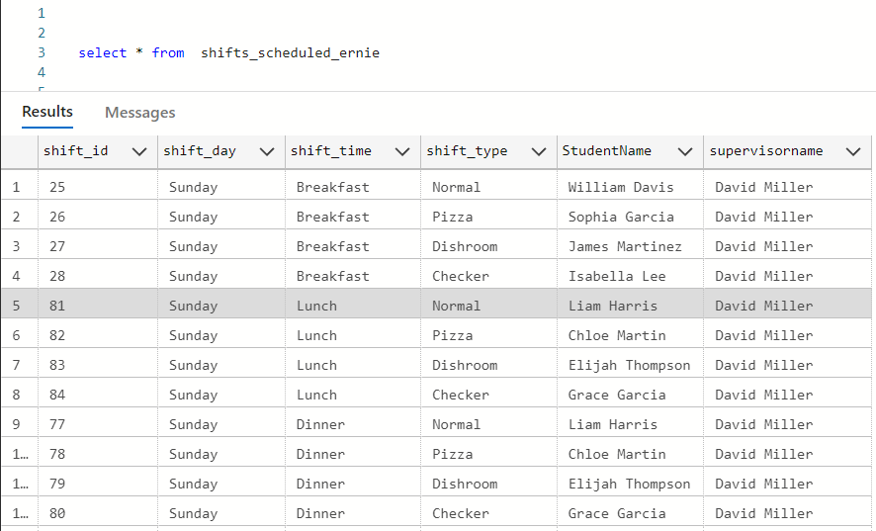
Shifts Arranged for Employees
insert into shifts_scheduled_ernie
select top(1000) shift_id,shift_day,shift_time ,shift_type,s2.student_firstname+' '+s2.Student_lastname as StudentName,s3.supervisor_firstname+' '+supervisor_lastname as supervisorname
from shifts s1
join student_employees s2 on s1.shift_student_id = s2.student_id
join supervisors s3 on s1.shift_supervisor = s3.supervisor_id
where shift_dining_id = 1
group by shift_day,shift_time,shift_type, s2.student_firstname,s2.student_lastname,supervisor_firstname,supervisor_lastname,shift_id
ORDER BY
CASE
WHEN shift_day = 'Sunday' THEN 1
WHEN shift_day = 'Monday' THEN 2
WHEN shift_day = 'Tuesday' THEN 3
WHEN shift_day = 'Wednesday' THEN 4
WHEN shift_day = 'Thursday' THEN 5
WHEN shift_day = 'Friday' THEN 6
WHEN shift_day = 'Saturday' THEN 7
END ASC,
CASE
when shift_time = 'Breakfast' then 1
when shift_time = 'Lunch' then 2
when shift_time = 'Dinner' then 3
END ASC

Slide 9
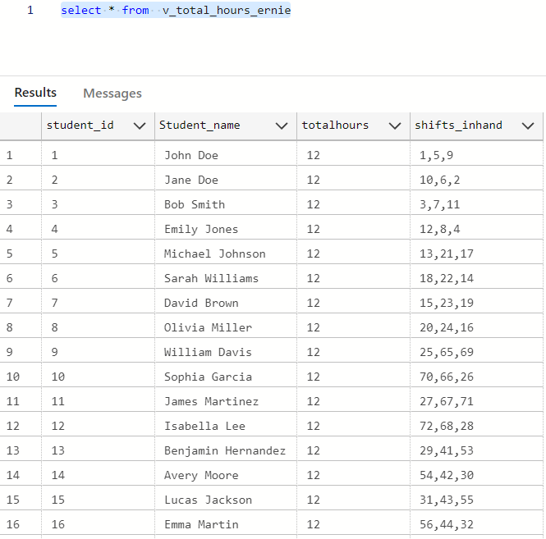
Total Hours for a Student Employee

Slide 10
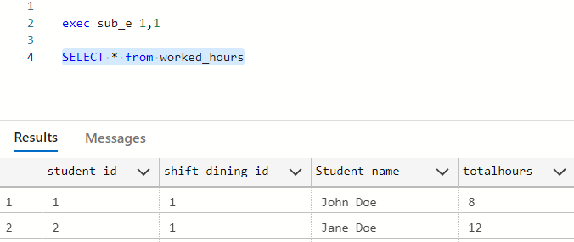
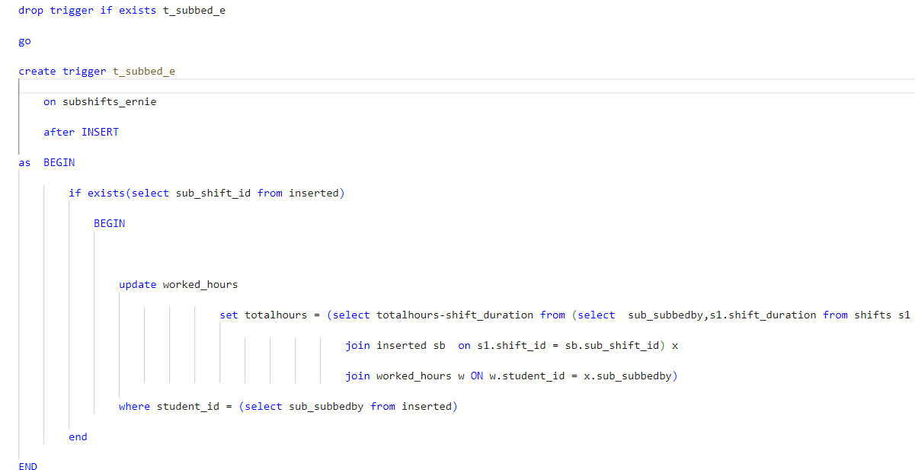
Sub Process
Execution of Stored procedure with the parameters of shift_id and student_id
When inserted a t_subbed_e will be triggered
When a student sub his/her shift, it will automatically reduces hours for the total shifts

Slide 11
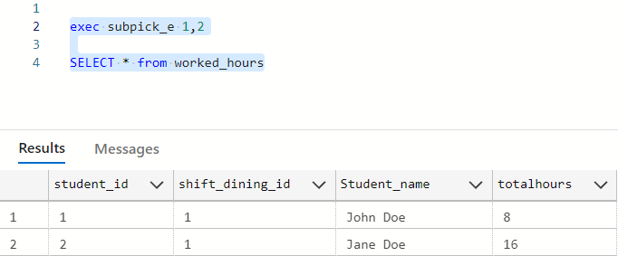
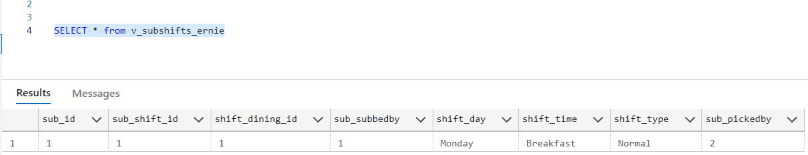
Sub Shift Picking
In the similar way we will execute a stored procedure with parameters sub_id from subshifts table and the student id of the employee picking the shift.
When a person picks a shift, the shift hours will be added to the worked hours, this is done using the trigger t_subpicked_e.
We are using the view to show the subshifts.

Slide 12
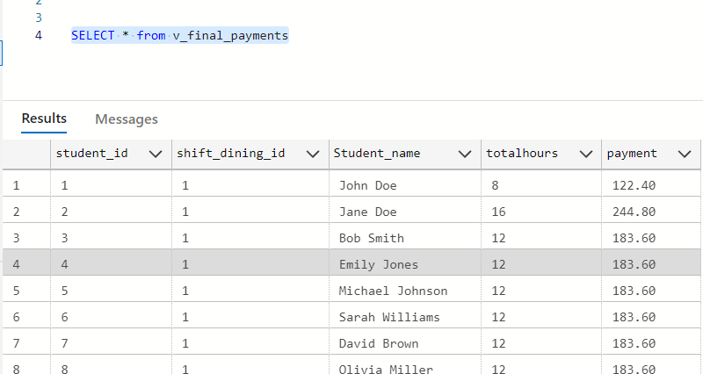
Payment View
Here the total amount is calculated with the help of totalhours, this view is generated from the worked_hours table

Slide 13
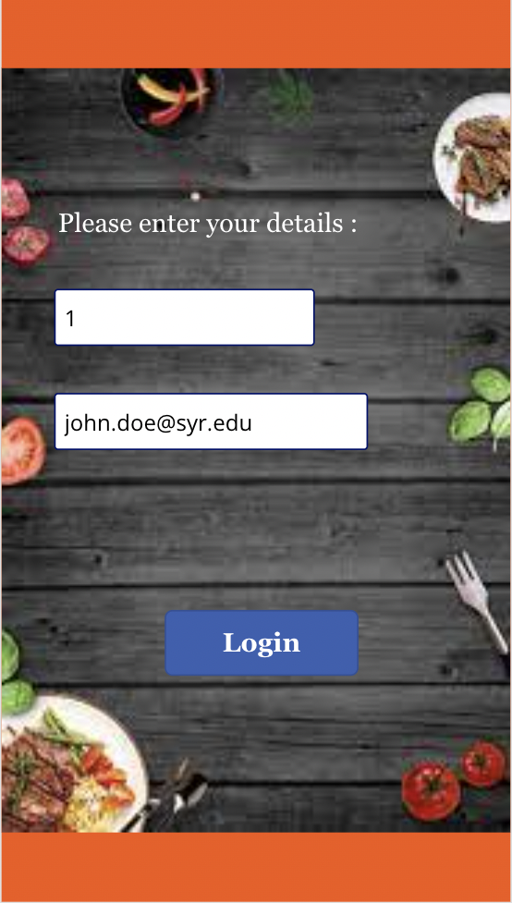

Screen in Power Apps
Home and Login Page

Slide 14
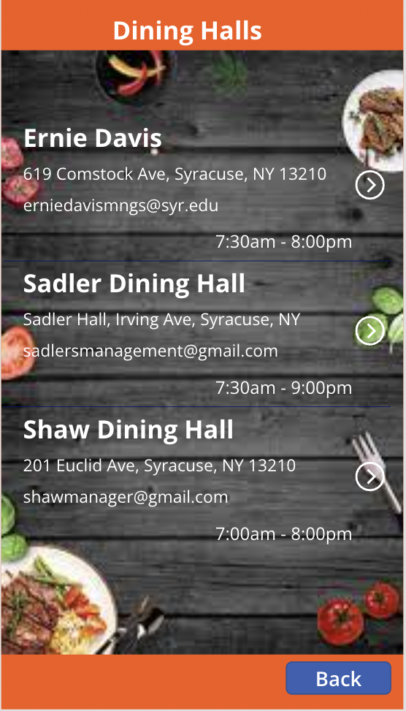
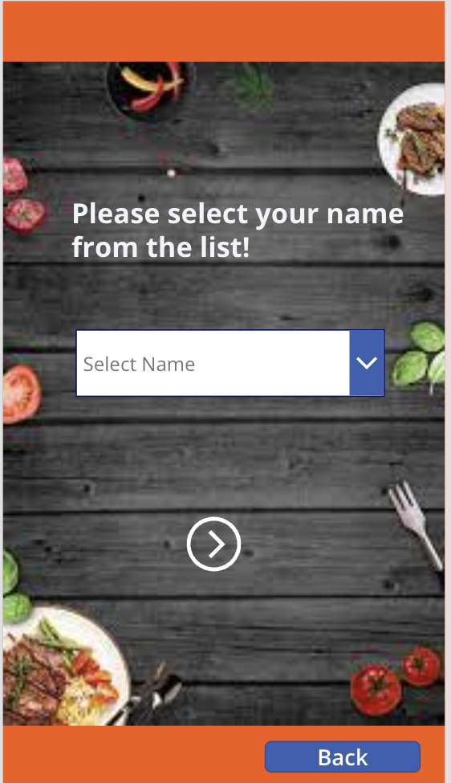

Dining Halls Page

Slide 15
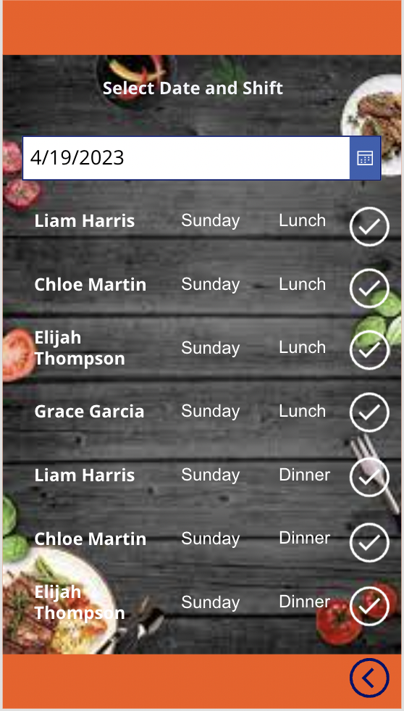
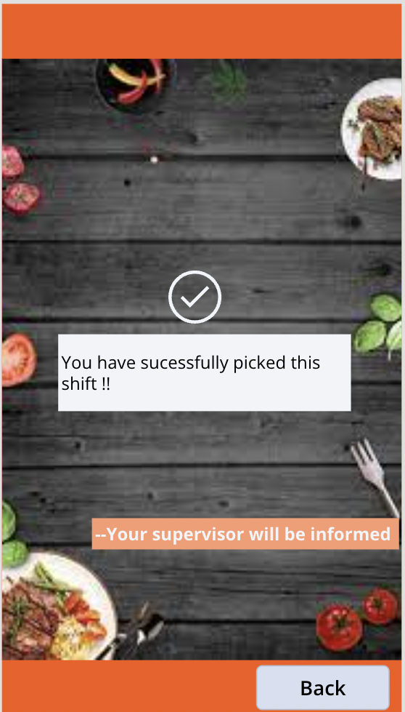
Pick Shift Page

Slide 16
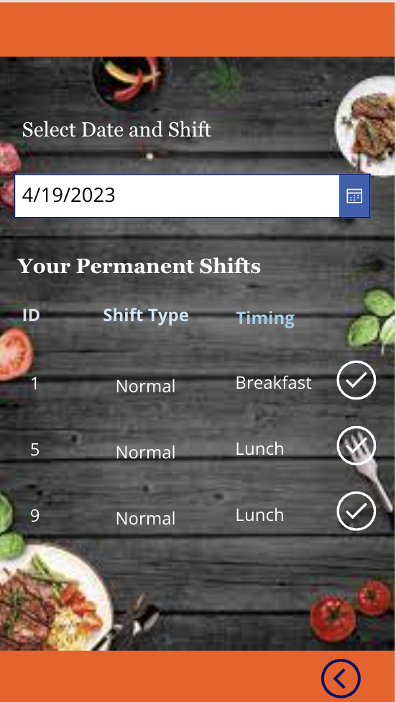
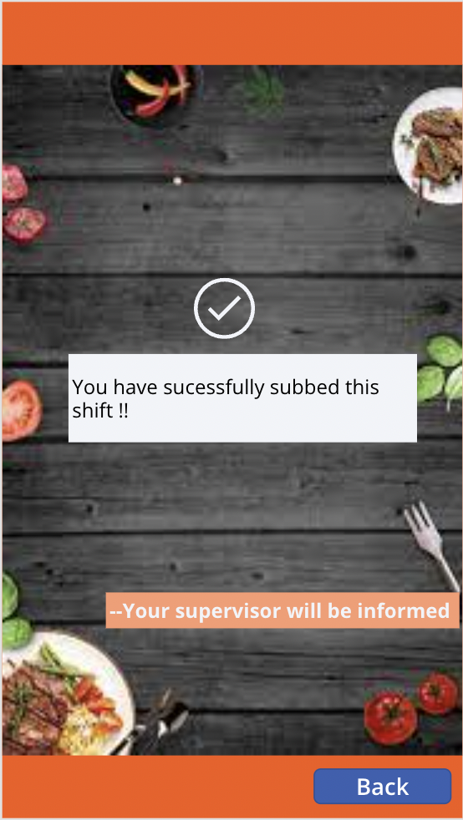
Sub Shift Page

Slide 17

Thank You

